Slide 1


Slide 2

Leave and attendance record system

Slide 3
Group Members Introduction
Muhammad Naeem Nasir
F220206E61 (BC190402334)

Slide 4

INTRODUCTION OF PROJECT
Leave and attendance record system is a web application made for management of employees’ attendance/ leave.
Following are included below:
Process Model Diagram
Use Case Diagram
Business Rules/ Functional Requirements
Architectural Design
Team Structure

Slide 5
INTRODUCTION OF PROJECT
Project Schedule
Sequence Diagrams
Class Diagram
Entity Relationship Diagram
Database Diagram
User Interface
Tools

Slide 6
Diagram of Process Model
Waterfall model
Requirements
Design
Implementation
Verification
Maintenance

Slide 7
Use Case Diagram

Slide 8
Functional Requirements
Employee functional requirements
Login/logout
Update personal profile
Time in/time out
Apply for leave
View Leave status
View total record of attendance/leave of the month/year
Admin functional requirements
Log in/log out
Register, Update, Delete employee
Add total number of leave/year
Process leave request
Automatic leave deduction from the employee leave record
View attendance/leave record of an employee

Slide 9
Architectural Design

Slide 10
Team Structure
Team consisted of only 1 developer who worked on:
- Gathering Specification Requirements and
Analyzing
- Design
- Coding
- Testing
- Presentation/ Report Development

Slide 11
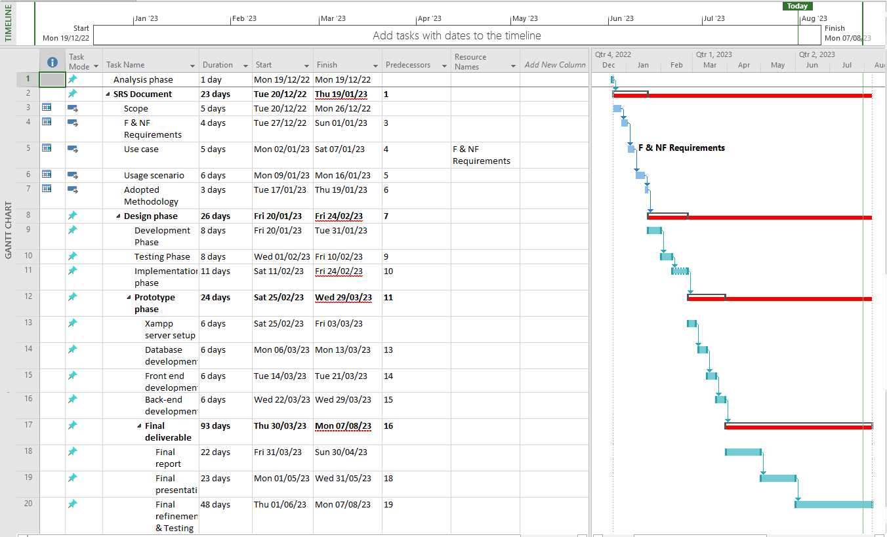
Project Schedule

Slide 12
Sequence Diagrams

Slide 13
Sequence Diagrams

Slide 14
Sequence Diagrams

Slide 15
Sequence Diagrams

Slide 16
Sequence Diagrams

Slide 17
Logical Model/Class Diagram

Slide 18
Entity-Relationship Diagram

Slide 19
Database Diagram

Slide 20
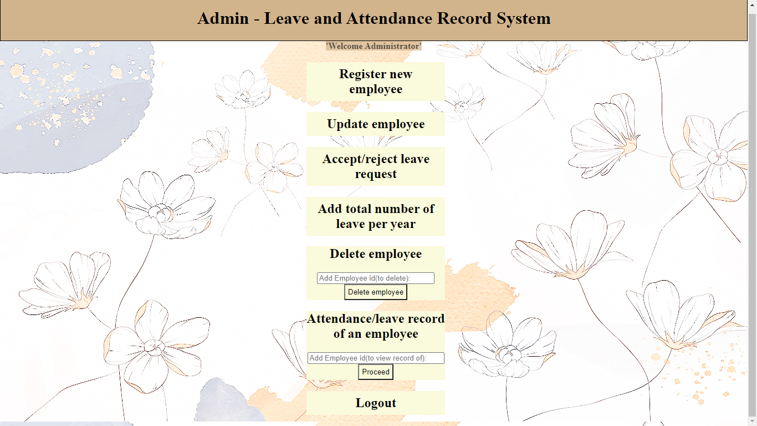
User Interfaces

Slide 21
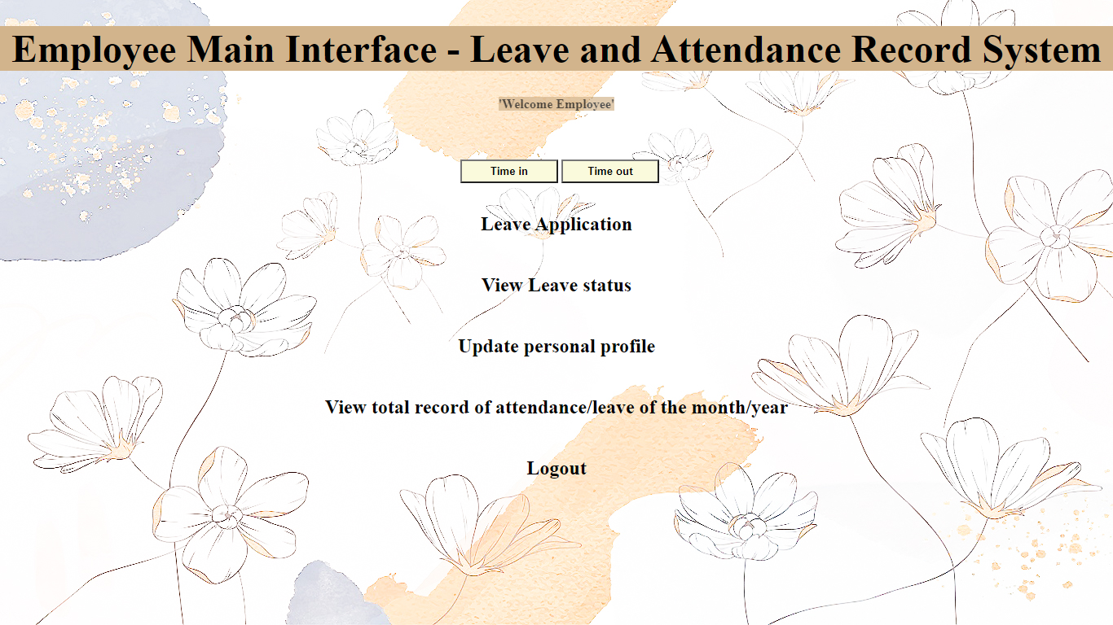
User Interfaces

Slide 22
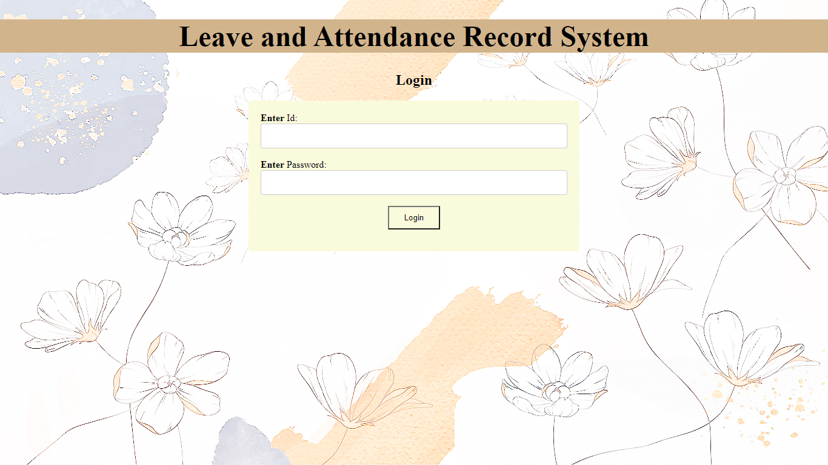
User Interfaces

Slide 23
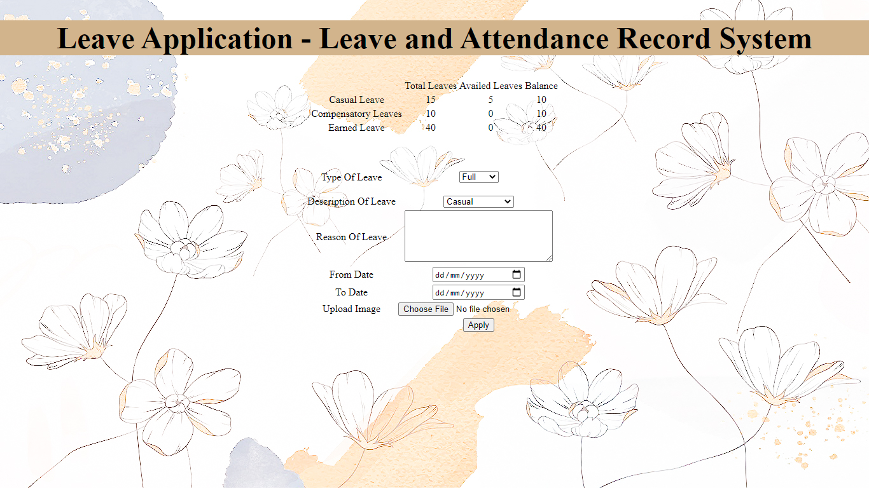
User Interfaces

Slide 24
Tools
Languages used on front-end:
HTML for webpage construction
CSS for stylizing webpages
Javascript for webpage responsiveness
Languages used on back-end:
PHP
Database:
MySQL
Other programs used:
XAMPP

